Slide 1
SEMIKUBE Three Phase Two Level Inverter
Update on testing for starting operation of Inverter
Tommaso Di Raimondo, Chirag Shah

Slide 2
Standard Operating Procedure (SOP)
Make use of three power supply channels (for Gate driver, PWM Signals and DC link)
Use voltage meters to check polarities and voltage levels
Always check the imposed current limits of power supplies
Arrange 24V DC supply voltage for Gate driver.
Datasheet for Gate Driver
Connect positive terminal to port 1, port 2 and port 3 and negative terminal to port 2, port 4 and port 6.
Note: Negative terminal is short circuited in gate driver therefore, it‘s alright even if only one port out of 2,4 and 6 is connected to negative of source
 | Min. | Rated | Max. | Unit
Supply voltage | 21.6 | 24 | 26.4 | V
Supply primary current no load | 360 |  |  | mA
Max. Supply primary current |  |  | 1500 | mA

Slide 3
Starting the Driver Circuit
Triggering Signal (port 8 and port 9)
To enable inverter this two port are utilized however care must be taken at starting.
Initially, connect both port 8 and port 9 to negative terminal. Make sure they are not floating!!!
After connecting the ports as per previous slide, turn the DC supply ON.
Blinking LED1 (left) in following sequence can be observed: ❶❷❸❹❺
Now, remove port 9 from negative terminal of DC supply and connect it to positive terminal.
Now, following sequence of LED1 (left) could be observed: ❶❷❸❹❺
If LED1 (left) sequence is according to mentioned above, driver circuit is working perfectly fine.
If not, then check the DC supply again and follow steps from starting.

Slide 4
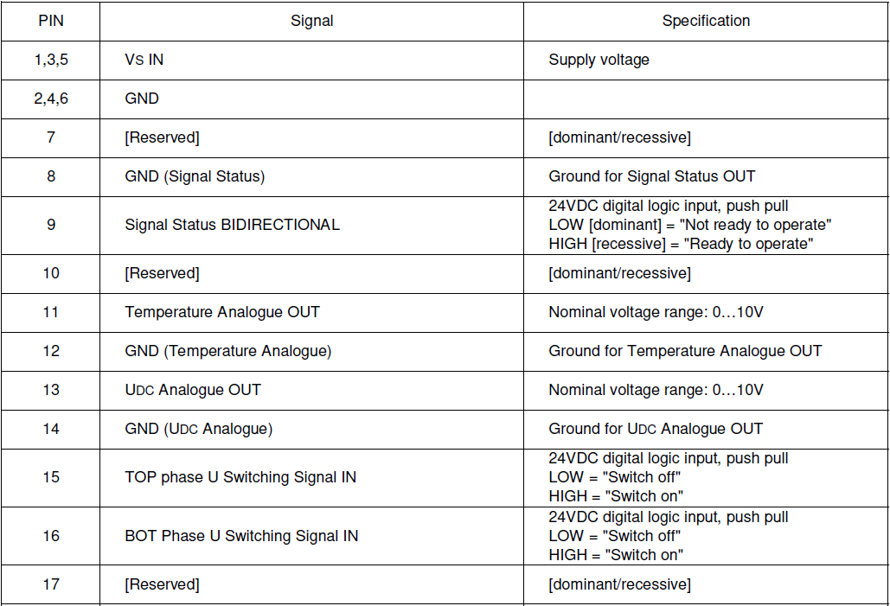
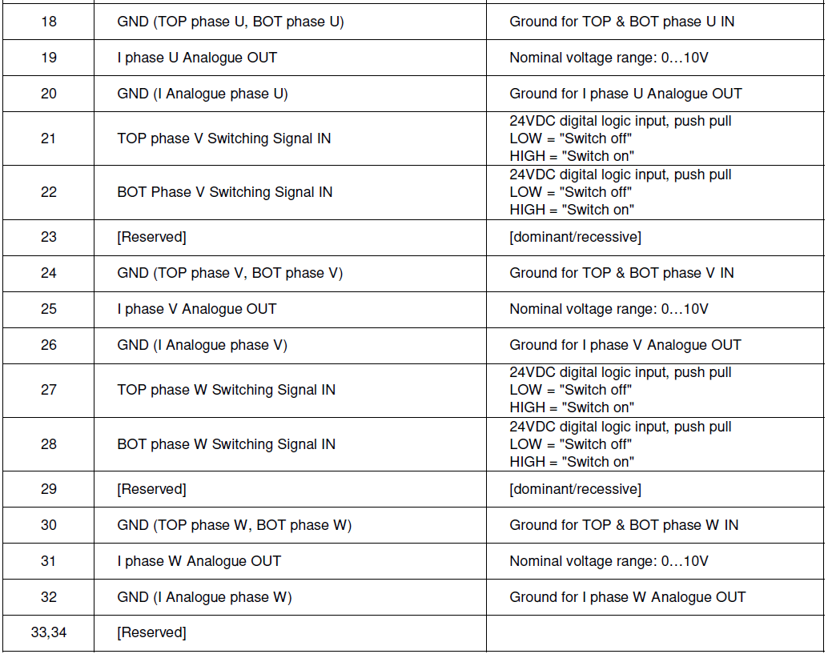
Checking the Controller Operation (TI LaunchPad)
Turn off the DC supply of Driver circuit.
Connect the ports of driver circuit to ports of main board according to manual.
Note: all grounds are shorted inside driver circuit so it does not matter to connect all or connect one

Slide 5
Checking the Operation of Inverter
The inverter starts only if all three phases switching signals have a reference value. Don’t keep it floating.
Using all three phases for testing of inverter is recommended.
Turn on the DC control supply for
Gate Driver
Main board
Give the input DC main power.
Observe the waveform at output of Inverter.
LED Color | Description
⓿ | OK. No failure.
⓿ | Failure was occurred, but failure is not present anymore
⓿ | Failure is present.

Slide 6
Diagnostic code:
LED sequence interpreting
LED 1 (left) and LED 0 (right) blink at 1Hz, after no illumination for three seconds the flashing sequence is repeated.
Refer to page. 64 of User Manual for a better understanding
LED 1 (left) | Description | LED 0 (right) | Description
❶ | (Status over current) Phase U | ❶ | (Status SKYPER 32PRO) Phase U
❷ | (Status over current) Phase V | ❷ | (Status SKYPER 32PRO) Phase V
❸ | (Status over current) Phase W | ❸ | (Status SKYPER 32PRO) Phase W
❹ | Status over temperature | ❹ | Status Internal generated +15V
❺ | Status HALT signal | ❺ | Status internal generated -15V
LED Color | Description
⓿ | OK. No failure.
⓿ | Failure was occurred, but failure is not present anymore
⓿ | Failure is present.

